Slide 1


Mansoura University Faculty of Computers and Information Department of Computer Science Second Semester- 2025-2026
Software Project Management
Lab 8
Basma Yasser

Slide 2
Outlines
Program Evaluation and Review Technique PERT.

Slide 3
Program Evaluation and Review Technique PERT
In CPM, the time estimates are assumed to be known with certainty. In certain projects like research and development, it is difficult to estimate the time of various activities.​
Hence, PERT is used in such projects with a probabilistic method using three-time estimates for an activity, rather than a single estimate.
The three estimates to be obtained for each activity are:
Optimistic Time (o): It is the shortest time taken to complete an activity.
Most likely Time (m): It is the normal time taken to complete an activity.
Pessimistic Time (p): It is the longest time taken to complete an activity.

Slide 4
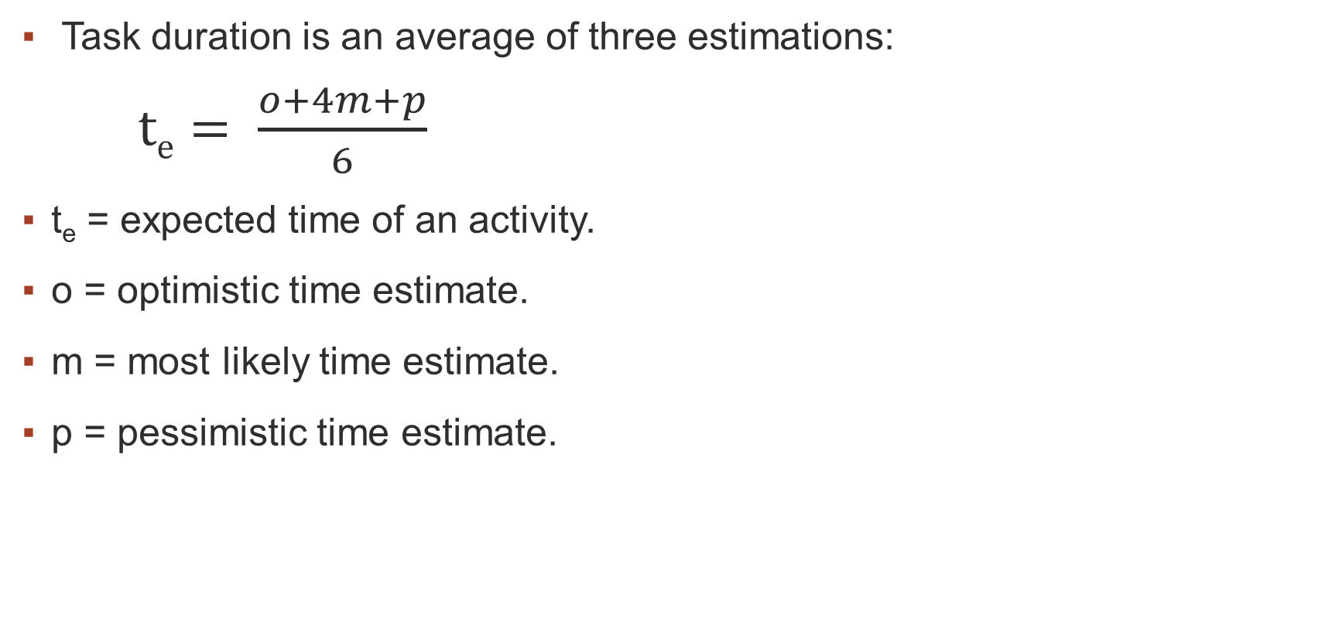
PERT Formula
Task duration is an average of three estimations:​
$te= \frac{o+4m+p}{6}$
t_{e} = expected time of an activity.
o = optimistic time estimate.
m = most likely time estimate.
p = pessimistic time estimate.

Slide 5

Variance (σ2) and standard deviation (σ)
$Variance \left(σ2\right)=v ={\left(\frac{p −o}{6}\right)}^{2}$
$\text{standard} \text{deviation} \text{σ} \text{= }\sqrt{Variance}$

Slide 6
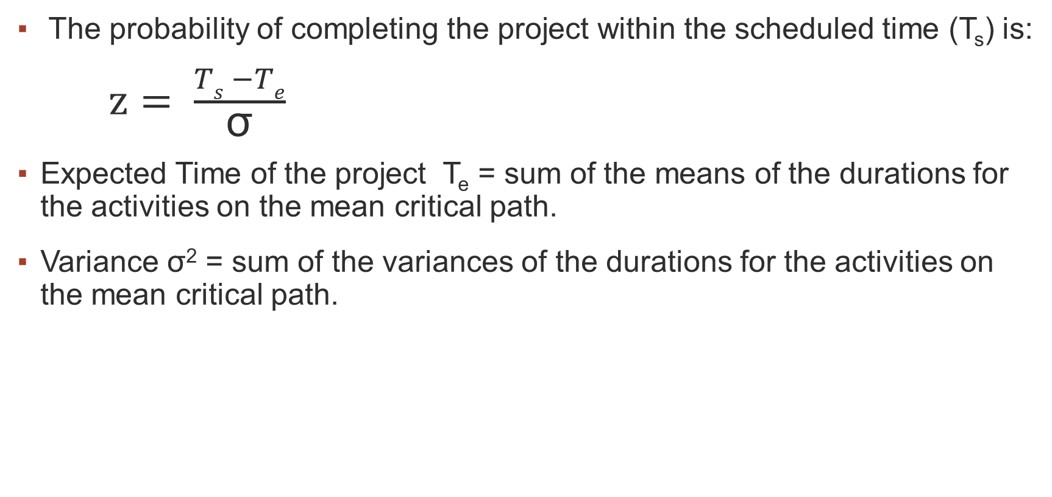
Probability For Project Duration​
The probability of completing the project within the scheduled time (T_{s}) is:​
$z= \frac{Ts −Te}{\text{σ}}$
Expected Time of the project T_{e} = sum of the means of the durations for the activities on the mean critical path.
Variance σ² = sum of the variances of the durations for the activities on the mean critical path​.

Slide 7
Example:
Calculate the expected time t per activity.​
With the t_{e} as calculated, draw the network and find the critical path and the expected project duration T_{e} .​
Activity | Predecessor | o | m | p | Expected Time (mean) t_{e} | Variance
A | - | 4 | 6 | 14
B | - | 4 | 9 | 14
C | A | 6 | 13 | 14
D | A, B | 4 | 8 | 12
E | D | 3 | 10 | 12
F | C, E | 5 | 5 | 11
G | E | 2 | 5 | 8

Slide 8
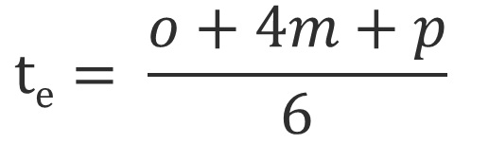
Example:
$$te= \frac{o+4m+p}{6}$$
Activity | Predecessor | o | m | p | Expected Time (mean) t_{e} | Variance
A | - | 4 | 6 | 14 | 7
B | - | 4 | 9 | 14 | 9
C | A | 6 | 13 | 14 | 12
D | A, B | 4 | 8 | 12 | 8
E | D | 3 | 10 | 12 | 9
F | C, E | 5 | 5 | 11 | 6
G | E | 2 | 5 | 8 | 5

Slide 9
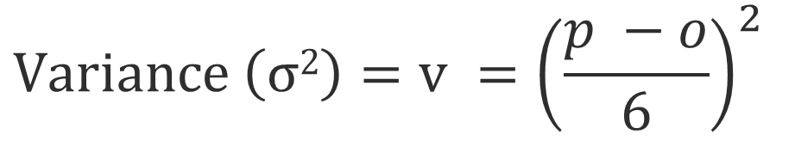
Example:
$$te= \frac{o+4m+p}{6}$$
$$Variance \left(σ2\right)=v ={\left(\frac{p −o}{6}\right)}^{2}$$
Activity | Predecessor | o | m | p | Expected Time (mean) t_{e} | Variance
A | - | 4 | 6 | 14 | 7 | 2.777
B | - | 4 | 9 | 14 | 9 | 2.777
C | A | 6 | 13 | 14 | 12 | 1.777
D | A, B | 4 | 8 | 12 | 8 | 1.777
E | D | 3 | 10 | 12 | 9 | 2.777
F | C, E | 5 | 5 | 11 | 6 | 1
G | E | 2 | 5 | 8 | 5 | 1

Slide 10
Forward Pass:
0 7
7 19
26 32
A
C
F
7
12
6
0 9
9 17
17 26
26 31
B
D
E
G
9
8
9
5

Slide 11
Backward Pass:
0 7
7 19
26 32
A
C
F
7
12
6
2 9
14 26
26 32
0 9
9 17
17 26
26 31
B
D
E
G
9
8
9
5
0 9
9 17
17 26
27 32

Slide 12
Critical Path:
A
C
F
7
12
6
B
D
E
G
9
8
9
5

Slide 13
Example:
Activity | Predecessor | o | m | p | Expected Time (mean) t_{e} | Variance
A | - | 4 | 6 | 14 | 7 | 2.777
B | - | 4 | 9 | 14 | 9 | 2.777
C | A | 6 | 13 | 14 | 12 | 1.777
D | A, B | 4 | 8 | 12 | 8 | 1.777
E | D | 3 | 10 | 12 | 9 | 2.777
F | C, E | 5 | 5 | 11 | 6 | 1
G | E | 2 | 5 | 8 | 5 | 1

Slide 14
Probability For Project Duration​
The probability of completing the project within the scheduled time (T_{s}) is:​
$z= \frac{Ts −Te}{\text{σ}}$
Expected Time of the project T_{e} = sum of the means of the durations for the activities on the mean critical path.
Variance σ² = sum of the variances of the durations for the activities on the mean critical path​.

Slide 15

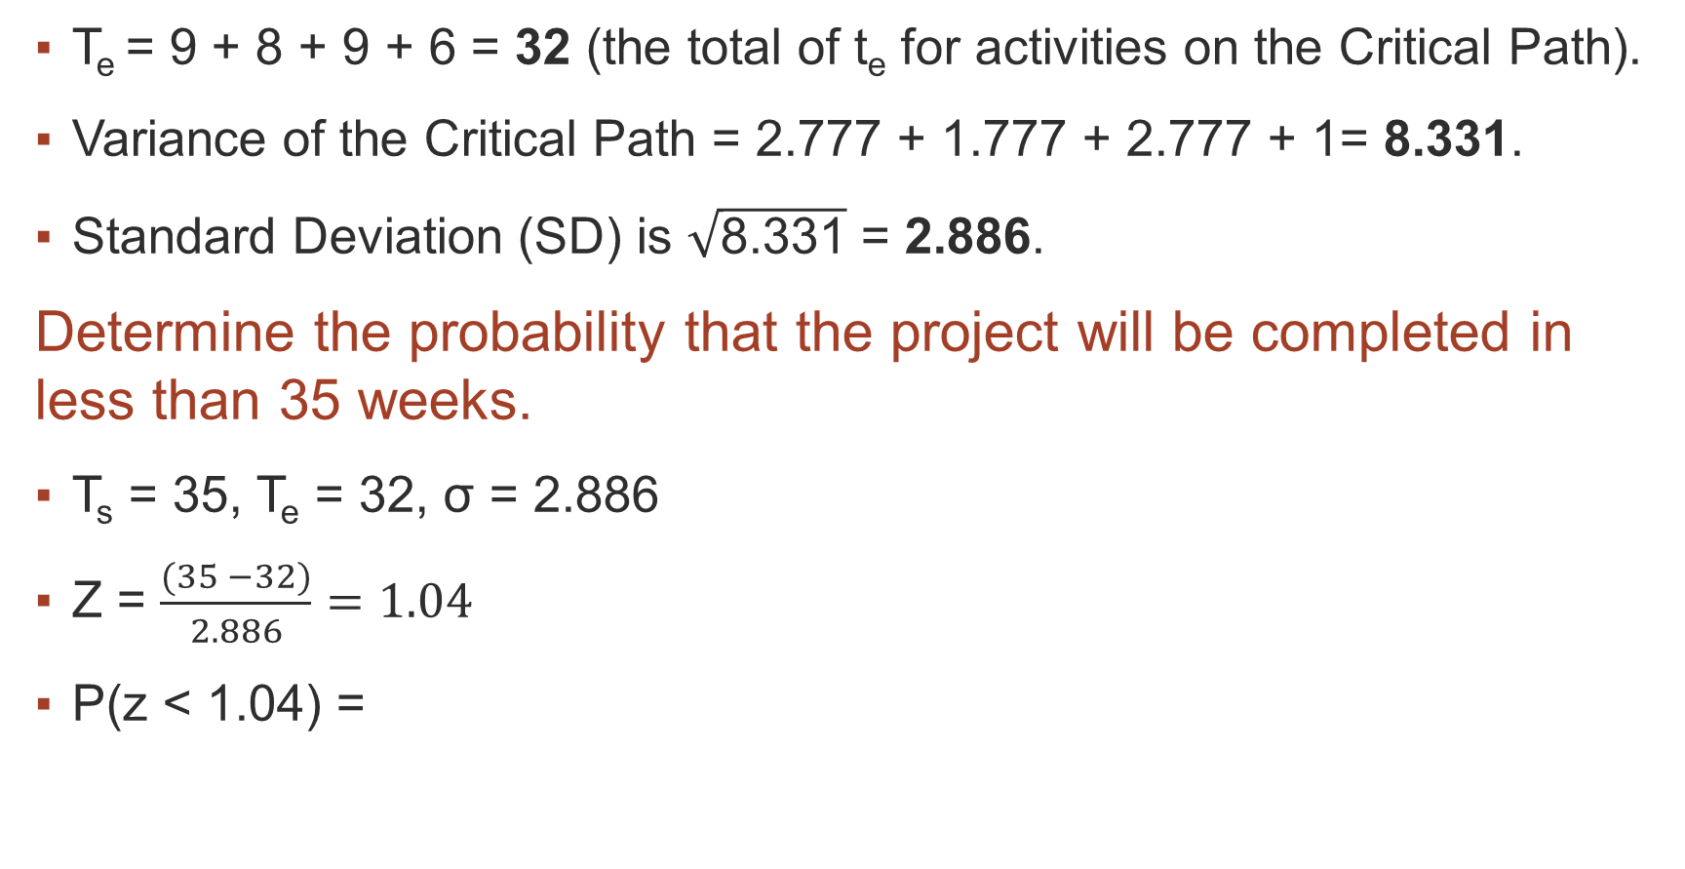
Example:
T_{e} ​= 9 + 8 + 9 + 6 = 32 (the total of t_{e} for activities on the Critical Path).
Variance of the Critical Path = 2.777 + 1.777 + 2.777 + 1= 8.331​.​
Standard Deviation (SD) is $\sqrt{\text{8.331}}$ = 2.886​.
Determine the probability that the project will be completed in less than 35 weeks.
T_{s} = 35​, T_{e} = 32​, σ = 2.886​
Z = $\frac{(35 −32)}{2.886}=1.04$
P(z < 1.04) =​
$$z= \frac{Ts −Te}{\text{σ}}$$

Slide 16
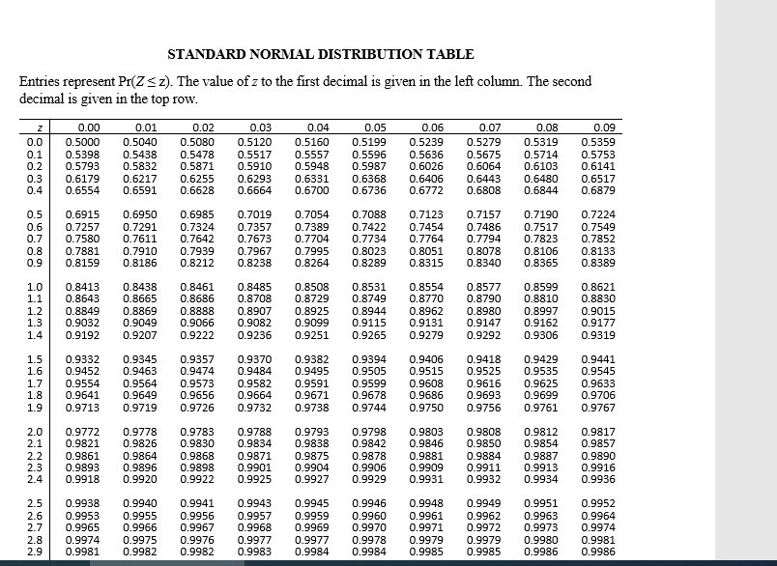

Slide 17
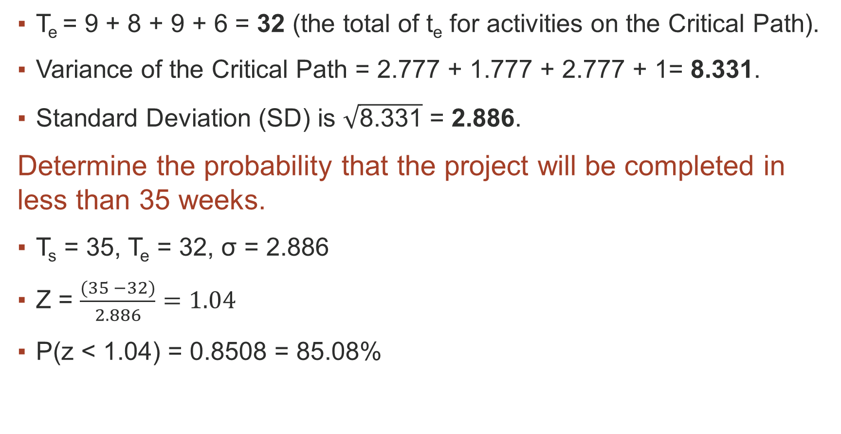
Example:
T_{e} ​= 9 + 8 + 9 + 6 = 32 (the total of t_{e} for activities on the Critical Path).
Variance of the Critical Path = 2.777 + 1.777 + 2.777 + 1= 8.331​.​
Standard Deviation (SD) is $\sqrt{\text{8.331}}$ = 2.886​.
Determine the probability that the project will be completed in less than 35 weeks.
T_{s} = 35​, T_{e} = 32​, σ = 2.886​
Z = $\frac{(35 −32)}{2.886}=1.04$
P(z < 1.04) =​ 0.8508 = 85.08%
$$z= \frac{Ts −Te}{\text{σ}}$$

Slide 18
Thank You

